Slide 1
Uncommon
Churchs

Slide 2
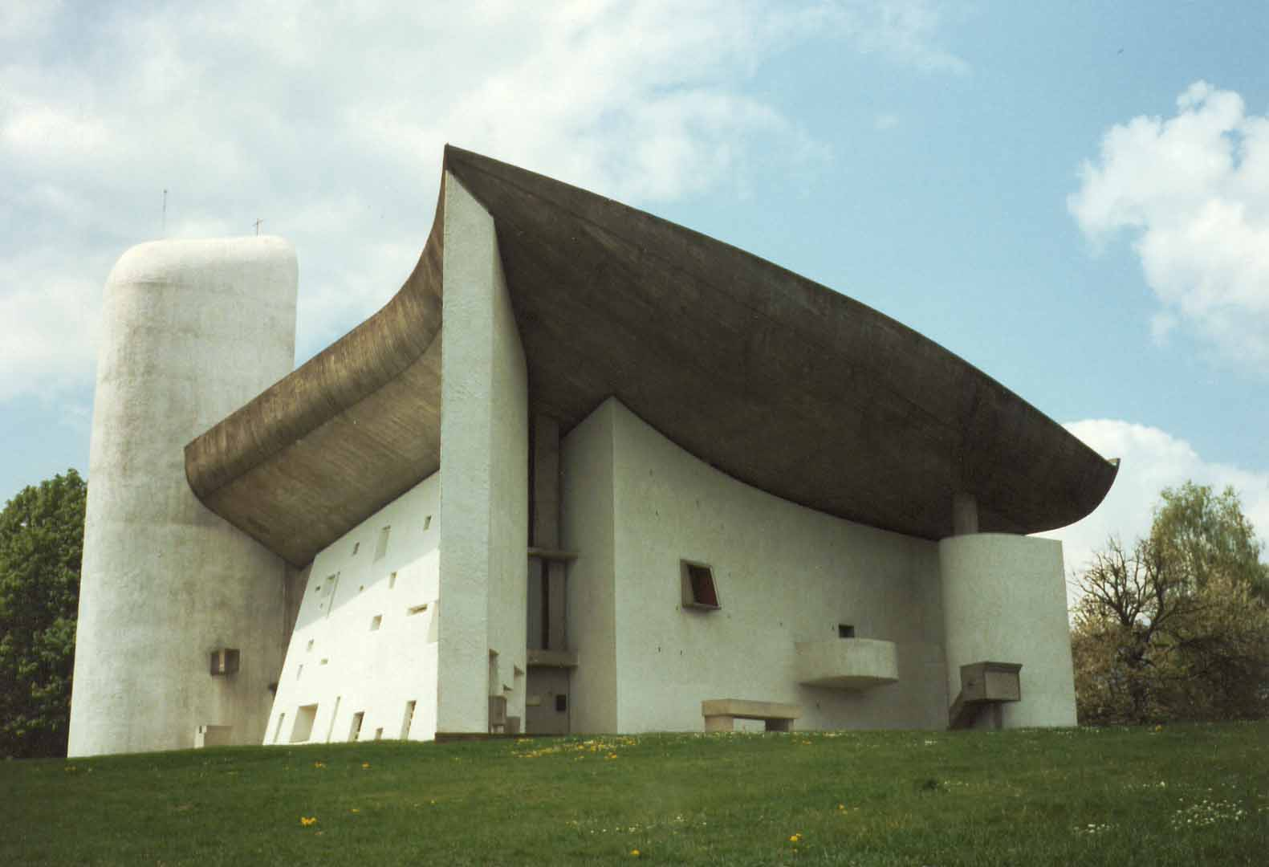
Chapel Notre-Dame-du-Haut de Ronchamp. Designed by the architect Le Corbusier, considered one of the most important of the century XX. The windows in the thick and curved walls let in a weak and indirect light. The previous church was destroyed during the second world war but a part of the ruins was used by the architect.

Slide 3
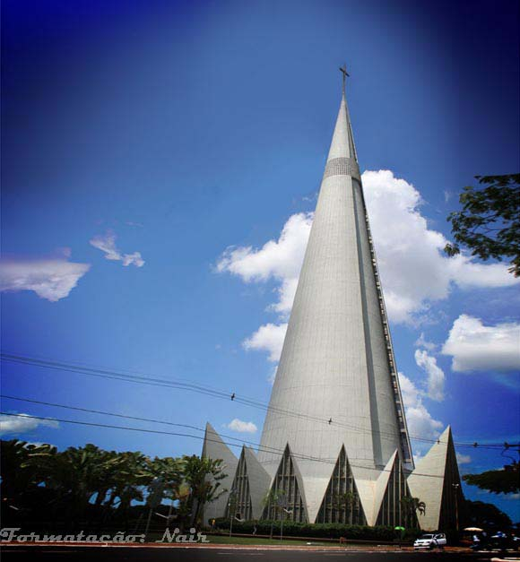
Cathedral of Our Lady of the Glory, Maringá, in the State of the Paraná, Brazil. Modern and bold architecture idealized by D.jaime Luiz Rabbit and Designed by the architect José Augusto Bellucci, inspired by the satellite Sputnik. The cone has an external height of
114 m, supporting a cross of 10 m. It has capacity to shelter 3.500 people.

Slide 4
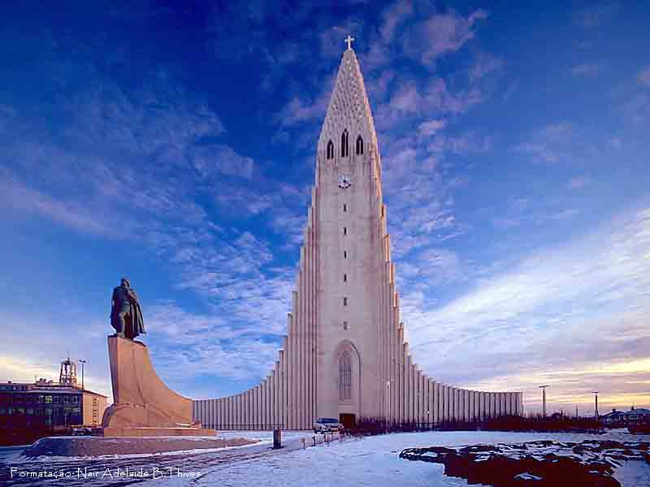
Lutheran Church in Reykjavik, Iceland. It took 38 years to build. Took the name of the priest and Icelandic poet Allgrímur Pétursson. With 74.5m of height, it is a fine example of architectural structure of Iceland.

Slide 5
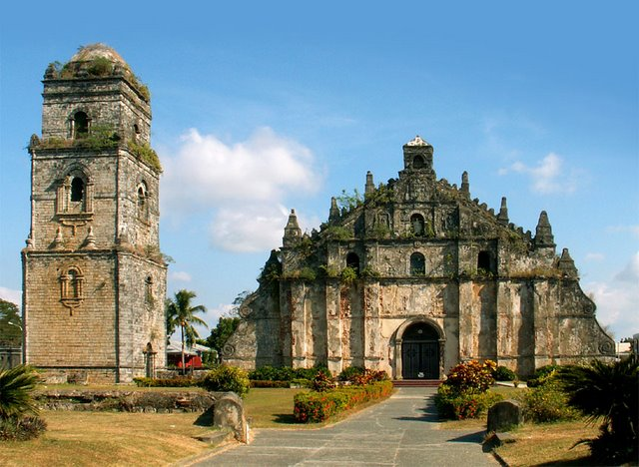
Church of Saint's Agostinho in Paoay, Philippines. Built between 1704 and 1894. Oriental and baroque influence. Located in an area with earthquakes, it was built with walls 1.67m thick.

Slide 6
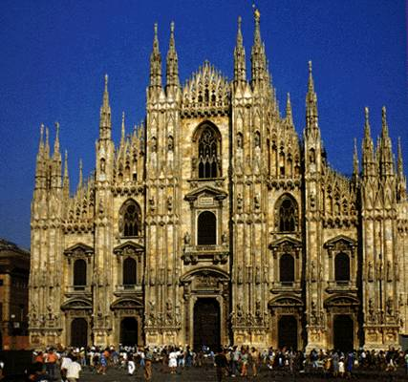
The Cathedral of Milan, Italy. The construction began in 1386 and took 200 years to be completed. An immense Gothic construction from white marble, it’s 1577 m in length, it accommodates up to 40,000 people in the interior.

Slide 7
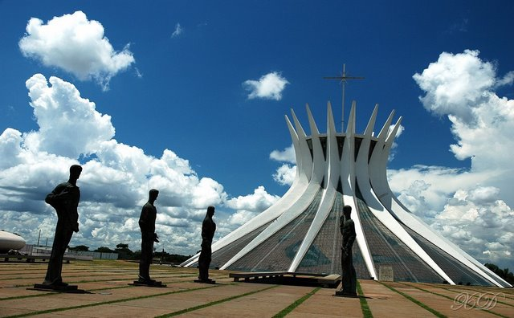
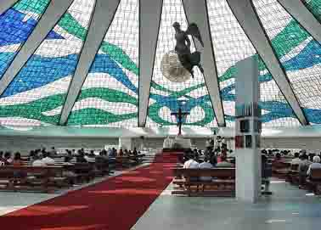
Brasilia Cathedral, in the capital of Brazil. Modern construction, of Oscar Niemeyer one of the most important architects of the present time. It has a circular area of 70 m of whose diameter there are lifted up 16 columns of concrete, which weigh 90 tons. The inauguration was in 1970,

Slide 8
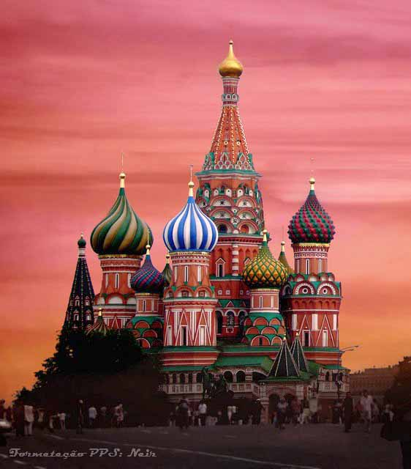
St.Basílio Cathedral, located in Red Square in Moscow.

Slide 9
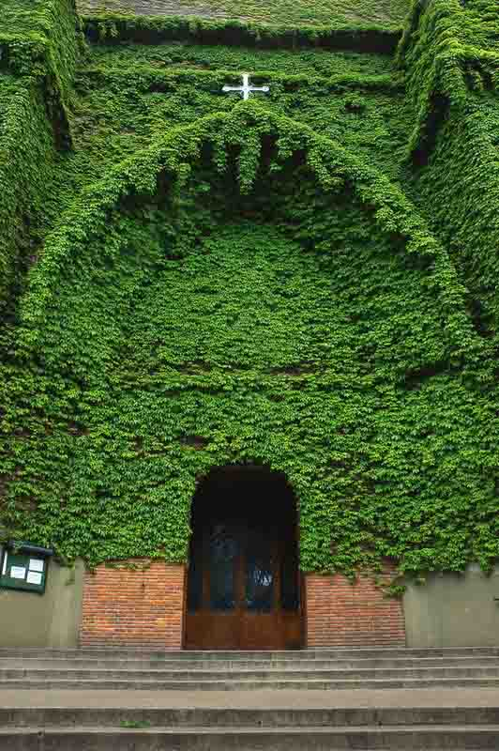
Church located in a parish of Buenos Aires, Argentina.

Slide 10
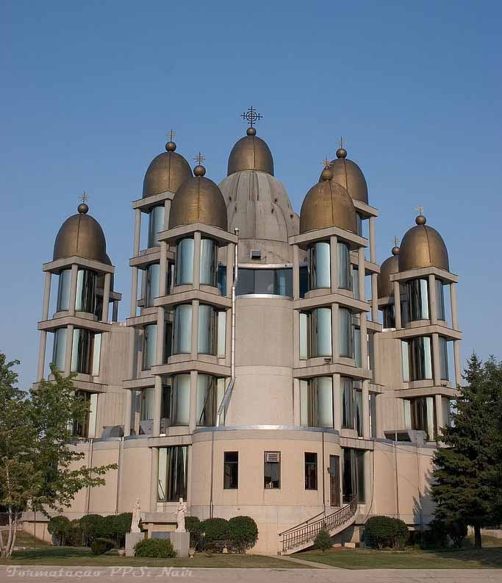
Catholic Ukrainian cathedral of Saint José in Chicago. The golden domes symbolize twelve apostles and Jesus Christ. It was finished in 1956. The interior is completely decorated in Byzantine style.

Slide 11
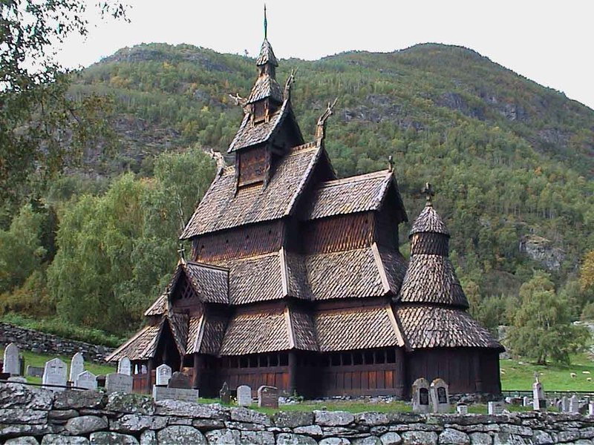
In the towns of Torpo and Borgund, in Norway. It dates from 1180 and is considered one of the symbols of Norway.

Slide 12
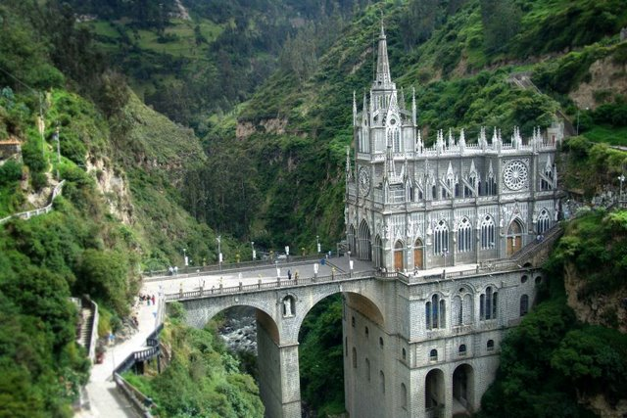
Cathedral of Our Lady of Las Lajas, Colombia. Built between 1916 and 1949 on two arches, in the river Canyon Guaitara. It is considered one of the wonders of Colombia..

Slide 13
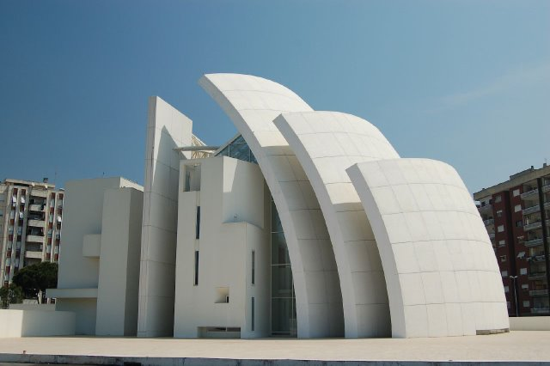
Church of the Jubilee, Rome, Italy. Finished in 1996, designed by the architect Richard Meier.

Slide 14
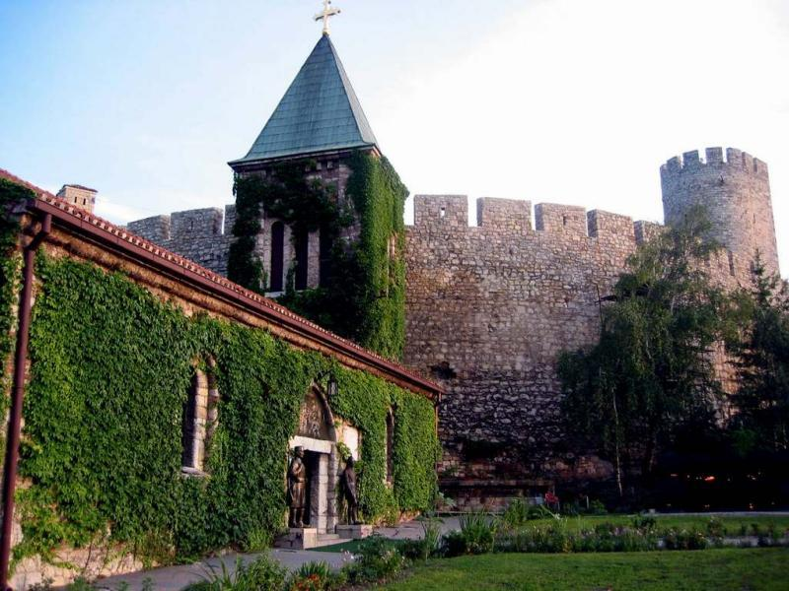
Rustic church located along the Fortress Kalemegdan in Belgrade, Serbia. It is a small chapel.The space was used by the Turks to warehouse gunpowder for more than a hundred years. It was rebuilt in 1920.

Slide 15
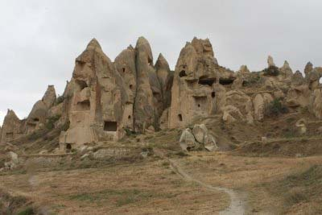
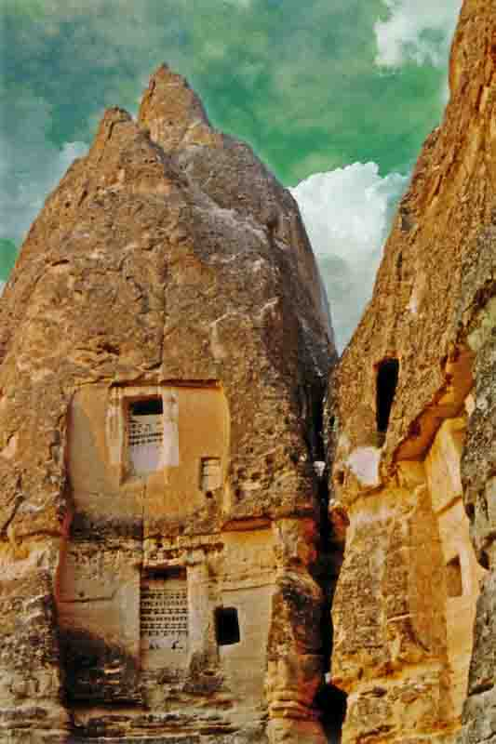
Göreme, city of the Capadócia, Turkey. The church structure, was excavated in the rock (soft rock been derived from lava) There Are more than 100 similar constructions in the region.

Slide 16
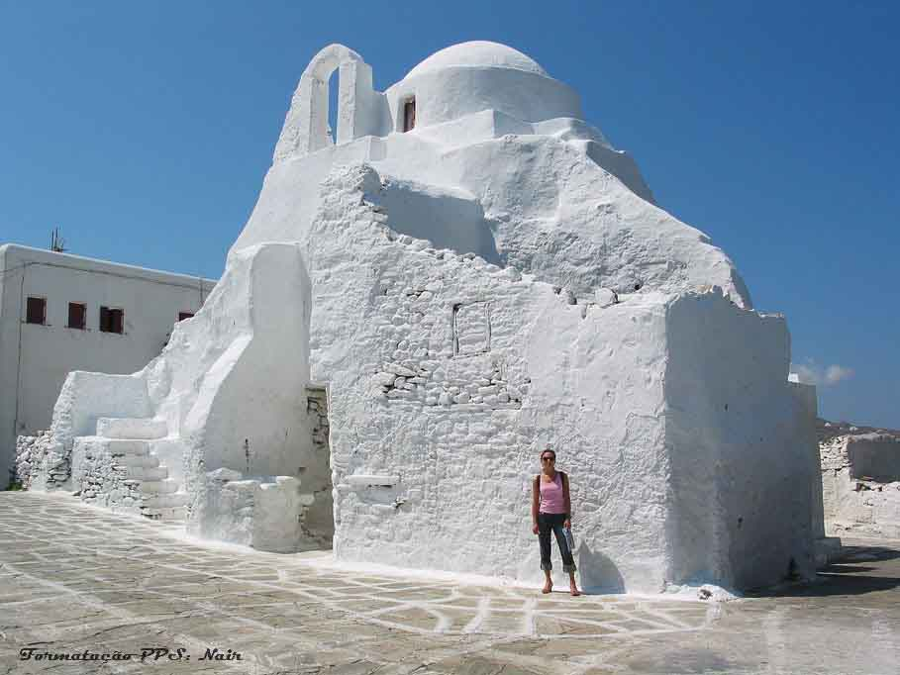
The Church of Paraportianí is in MyKonos, Greece. The name means " secondary gate " because it was built with stone in the place of one of the gates of the medieval walls. The construction was initiated in 1425.

Slide 17
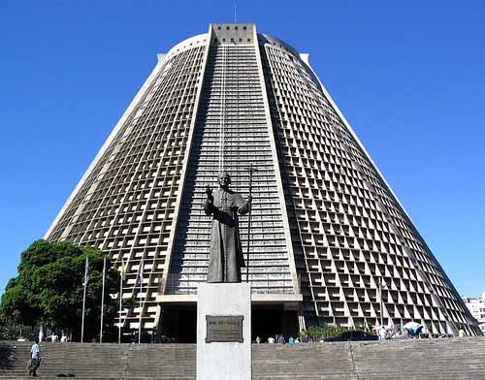
Cathedral of Rio de Janeiro Brazil. Built between 1964 and 1979.

Slide 18
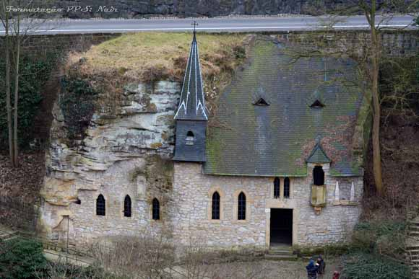
Chapel of S.Quirino, built in a slope, in Luxembourg. Constructedi in 355. In a previous time, the place was used for pagan worship. It is near a rocky fountain, with water that has miraculous effects, for diseases of the eyes.

Slide 19
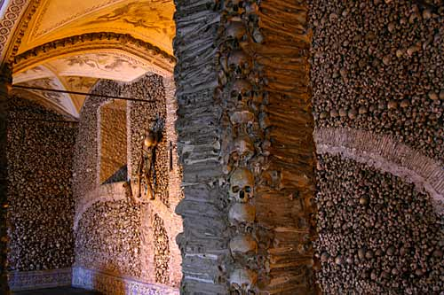
Chapel of the Bones. It is in the Church of Saint Francisco, in Evora, Portugal. Built in the century XVII by initiative of three monks. It’s walls and eight pillars are decorated by bones and skulls held by grey cement.

Slide 20
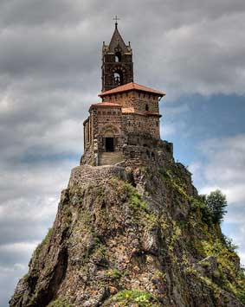
Chapel of St Michael of Ainguilhe, in Puy Velay, in France. It was built in the year 962 on a volcanic stone, for the Bishop Gothescalk after the return of a pilgrimage for Santiago of Compostella. In 1955, in an hidden area, the workers found many relics under the altar. In 1429 the mother of Joan of Arc, Isabella Romee was in this church.

Slide 21
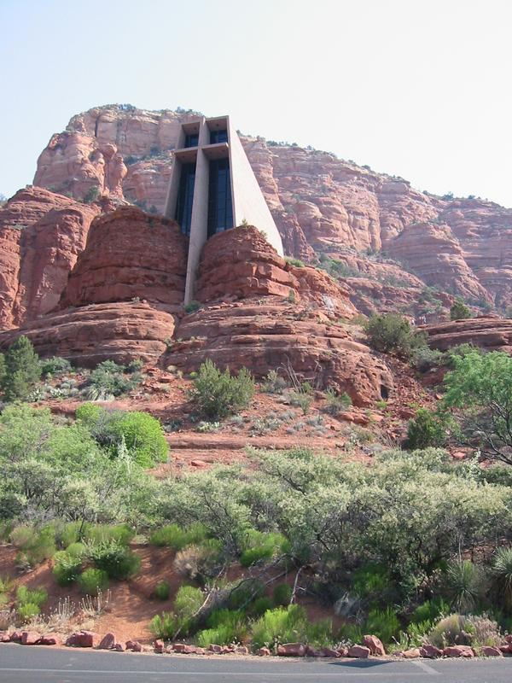
Chapel of Holy Cross. Modern architecture, built in the rock, in Arizona, U.S.A. Finished in 1956. They say that visitors that go into it’s interior feel a strong spiritual energy and a sense of great peace.

Slide 22
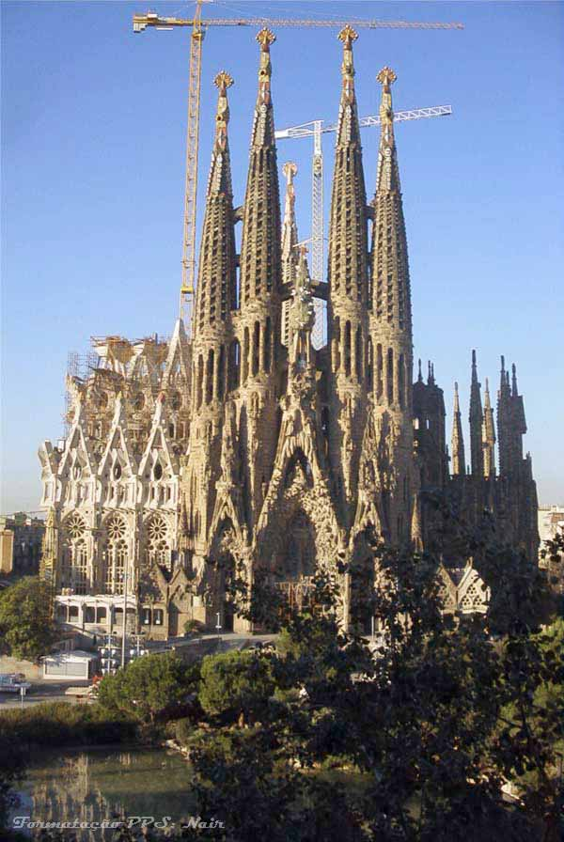
Basilica of the Sacred Family, in Barcelona, Spain. The construction began in 1882. Antoni Gaudí worked on the project for 40 years. The towers are 170m high.

Slide 23
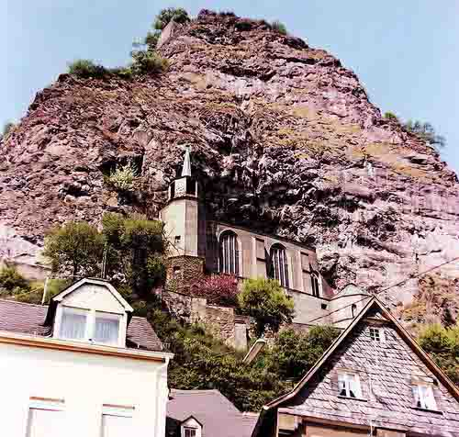
The city of Idar,
Germany.
The structure was built between 1482 and 1484.

Slide 24
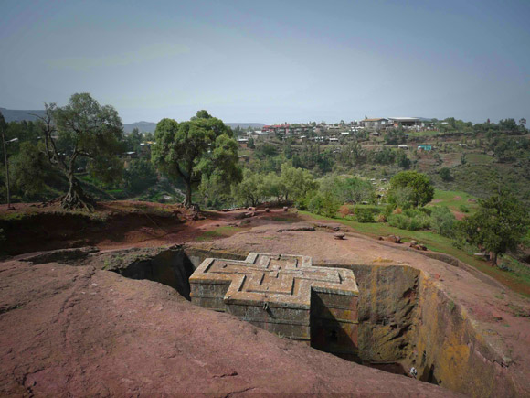
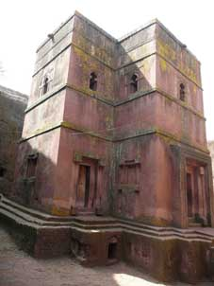
Church of St. George, Lalibela, in Ethiopia. It was built in the form of a cross in the stone.

Slide 25
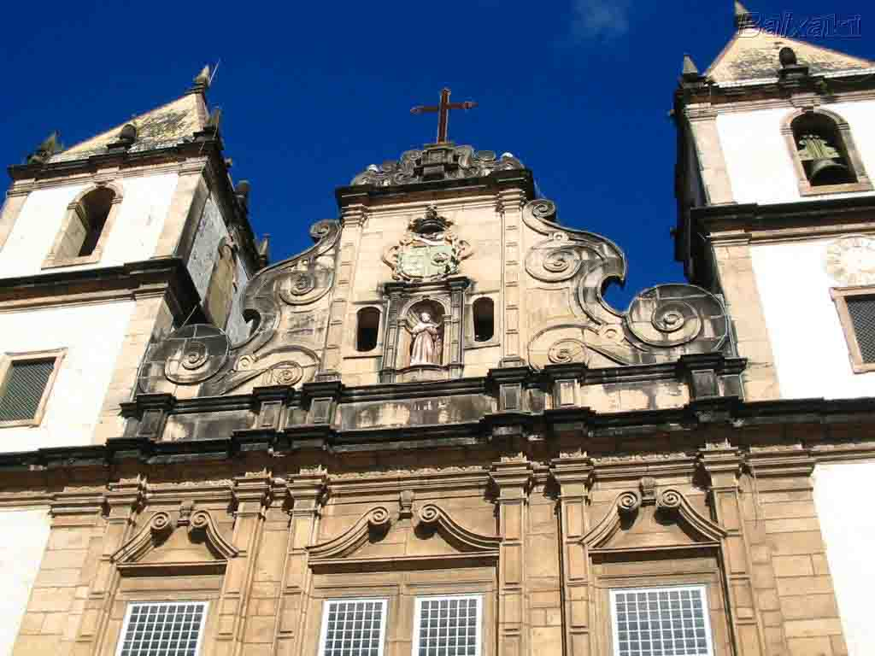
Church of Saint Francisco
Savior, Bahia, Brazil

Slide 26
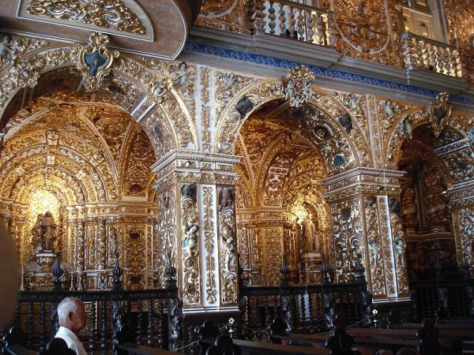

Slide 27
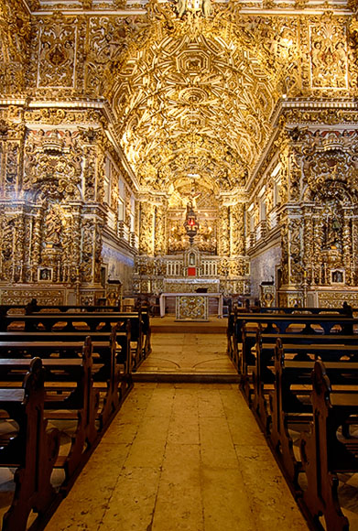
It is part of the convent of the FIt in the convent of the Franciscans.
It was finished in 1723.
Rut is considered to be one of the most extraordinary monuments in the world. It is precious for the exuberant decoration covered with leaves of gold, with carve in jacaranda, fleurons, borders, arches, angels' figures and birds spread in several points, beside panels in Portuguese ceramic tiles, showing scenes of the life of Franciscoranciscans. It was finished in 1723. Rut is considered one of the most extraordinary monuments in the world. It is precious for the exuberant internal decoration covered with leaves of gold, with carve in jacaranda, fleurons, borders, arches, angels' figures and birds spread in several points, besides panels in Portuguese ceramic tiles, showing scenes of the life of S. Francisco

Slide 28
There are many churches in this presentation. Uncommon in their architecture, in the location, in the grandeur, in their history.

